Slide 1
Modern Control Theory
Model Predict Control - MPC – Lecture 3
Dynamic Prediction Models

Slide 2
Free response and forced response
Free response –
Check if the system with current input can reach to the set-point or
Find out how close it can take it to the set-point or objective
Forced response –
Don’t make any control action if the system can reach to the set-point or
Compute control actions that can take it to the set-point or objective over and above the free response.

Slide 3
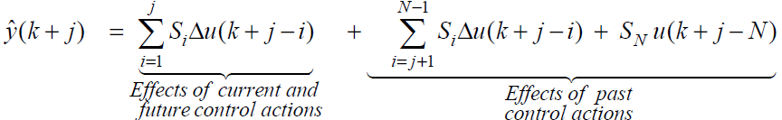


Step response prediction (2/2)
j^{th} step ahead prediction
What happens when u(k-i) = u(k-1) for all i > 0
Predicted FREE response
=

Slide 4
Example – simple predictive receding horizon controller
Find a predictive control law with single receding horizon move, such that
j^{th} step ahead prediction
Given
j = J,
Δu(k + i) = 0 for i > 0, i.e. Δu(k + 1) = Δu(k + 2) …. = Δu(k + J-1) = 0
Free response
Forced response
SISO system with prediction-based control law using simple step response coefficients
y_{sp} =
What are the pitfalls in this?

Slide 5
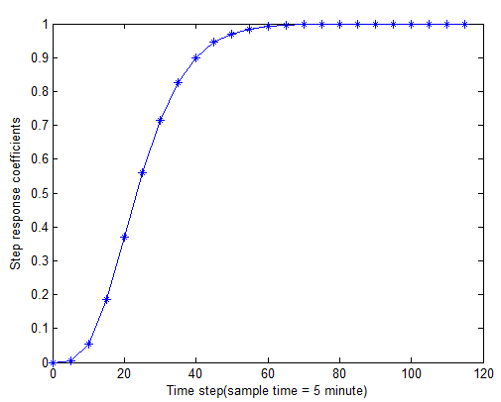
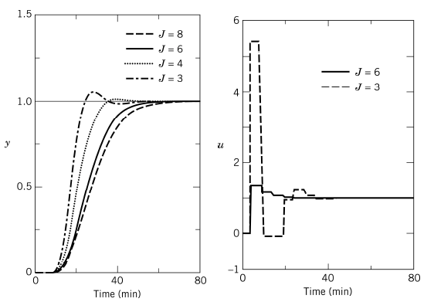
Example – simple predictive receding horizon controller
J = 3, 4, 6, 8
Δt = 5 mins
As J increases Sj increases
The move required tend to be smaller as J increases
As J decreases, y becomes aggressive

Slide 6
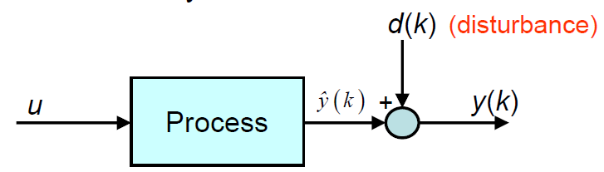

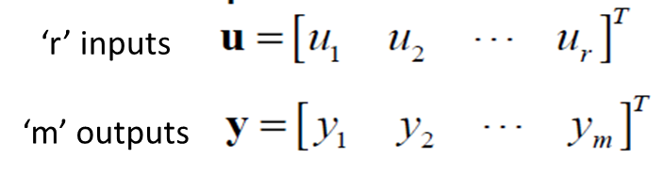

Correcting for model prediction errors – output feedback
When can predictions drift away actual?
Inaccurate model
Unmeasured disturbances
How do we correct the model predictions?
Output feedback based on the latest measurement
MIMO Model prediction with bias correction
Bias term or
correction term or
Estimated disturbance
is matrix of ‘1’ with dimension mP xm

Slide 7
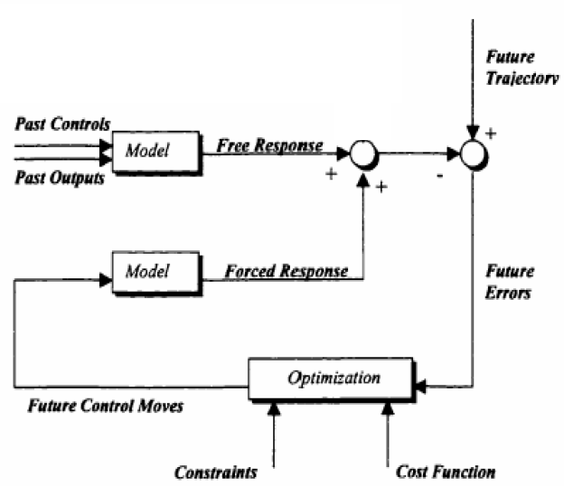
MPC Components

Slide 8
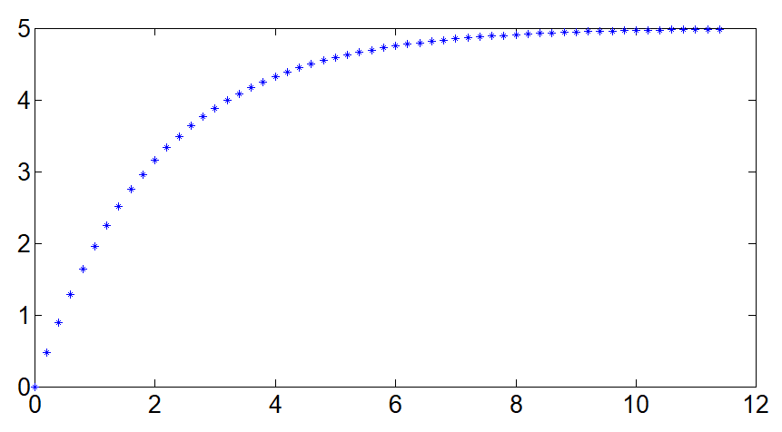
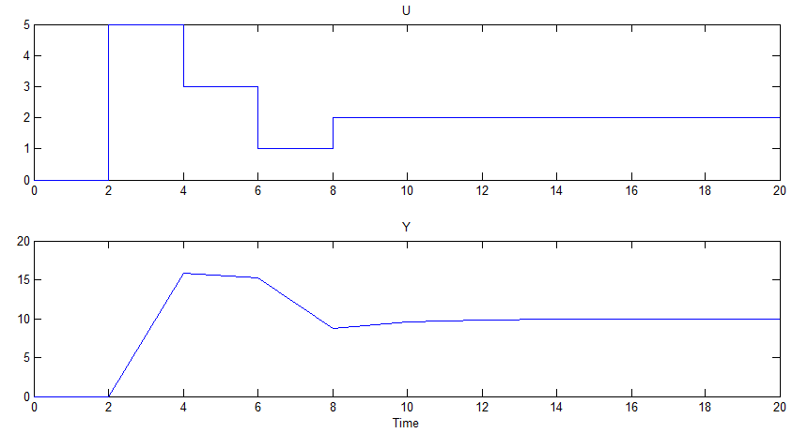
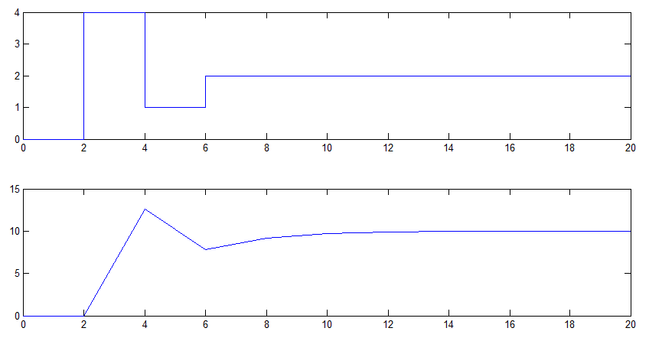
Why have multiple control moves?
Example
5/(2s+1)
u
Process
y
Controller
u
Process
y
y →10, what should be u?
u = 2

Slide 9
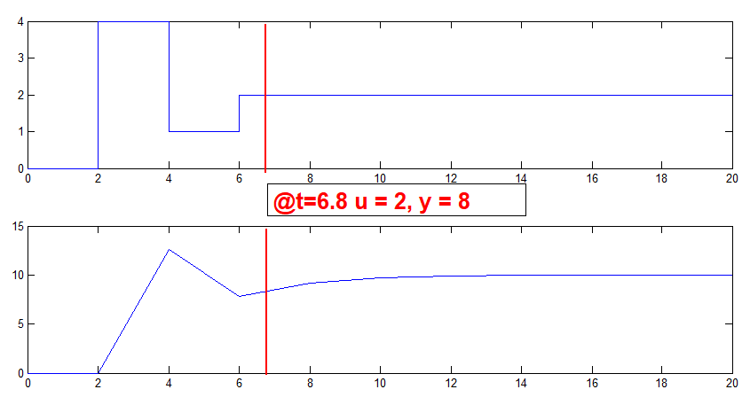
Does controller need to make control move all the time?
Example
5/(2s+1)
Controller
u
Process
y
y →10
What should controller do?
NO ACTION REQUIRED as it will reach to its Target

Slide 10
Dynamic prediction models
Model types
Physics based or data-based (or empirical) models
Linear or non-linear relationships
Types of Linear models
Impulse response coefficients
Step response coefficients – Most process industry implementations
Transfer function
State-space – Recent applications such autonomous vehicles, robots, satellite systems, etc

Slide 11
State space models - Motivation
5 CVs * 5 MVs
Each model has 30 coefficients
Total - ?
Mixed time scale – what is this?
Unstable system? Can I represent as step coefficients?
Type of disturbances that can be modeled?

